Slide 1
Design by Contract in a Layered Library Management System
Presented by:
Anil Manyam (202483873)
Rama satya Narayana (202480704)

Slide 2
Contents
Introduction
Literature Review
System Architecture
Methodology & System Design
Results & Discussion
Future Work & Limitations

Slide 3
Introduction
Library Management Systems (LMS) have become essential tools in academic and public libraries, helping manage critical operations such as lending and returning books, user registration, fine calculation, and maintaining borrowing histories.
As library usage grows and user expectations shift toward seamless digital interactions, modern LMS solutions must also handle complex policies like borrowing limits, varied loan durations, and role-based access.

Slide 4
Literature review
The following three studies provide a strong foundation for understanding how this project’s architectural and methodological choices align with current research trends.
A Systematic Mapping Study on Contract-Based Software Design (Okumuş et al., 2025)
Key insights from their review emphasize that contract-based development enhances component reusability and promotes safe interchangeability between modules.
This study validates the decision to apply icontract in the LMS backend, confirming that such tools not only help enforce business logic but also position the system for future scalability, including microservice migration, without compromising correctness [1].

Slide 5
Cont..
Applying Design by Contract: Insights from Engineering Practice (Meyer, 1992)
Bertrand Meyer’s seminal work on Design by Contract laid the foundation for understanding contracts as both formal specifications and executable components in software development [2].
Meyer further discusses how Eiffel’s environment enforces contracts at runtime, enabling early detection of violations and improving software reliability.
A key takeaway from Meyer’s work is the ability of contracts to clearly define the source of errors in distributed or layered systems, improving traceability and debugging [2].

Slide 6
Cont..
Ontology-Based Library Management: Building a Semantic LMS (Mohd et al., 2020)
While many systems rely on procedural or contract-based logic, Mohd et al. propose an entirely different approach to library management using semantic web technologies and ontologies [3].
One of the key strengths of this ontology-based approach is reasoning.
The use of semantic standards like RDF and OWL also makes the system highly interoperable with external catalogs and linked data sources [3].

Slide 7
System architecture
This Library Management System (LMS) is designed using a three-tier layered architecture, separating the system into the presentation, service, and data layers.
Layered Architectural Model:
Presentation Layer (React.js): Provides a responsive, component-based user interface.
Service Layer (Flask): Acts as the middleware, exposing a REST API. It applies business logic, validates inputs using Design by Contract (icontract),

Slide 8
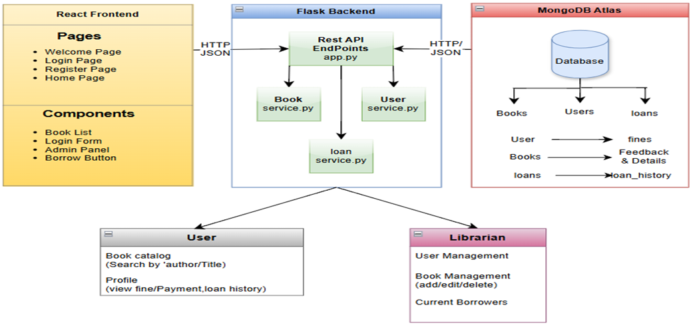
Cont..
Data Layer (MongoDB Atlas):
A cloud-based NoSQL database that stores structured collections for users, books, loans, loan history, and feedback. Its schema-less design allows easy data model evolution.

Slide 9
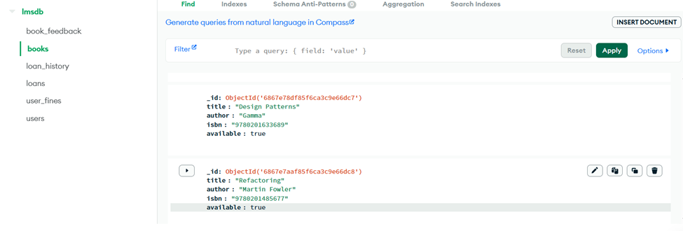
Cont..
Data Persistence Strategy:
MongoDB Atlas offers flexibility through its document-oriented storage and global accessibility. Key collections include users, books, loans, loan_history, and book_feedback. Indexes on fields like username and book_id ensure fast data retrieval, while replica sets enhance fault tolerance and availability.

Slide 10
Methodology & system design
Requirements Analysis:
The requirements were divided into two categories: functional requirements (e.g., borrowing, returning, viewing history, managing books, and submitting feedback) and non-functional requirements, which focus on maintainability, scalability, security, cloud availability, and formal correctness.
Design by Contract Implementation:
In this project, Design by Contract (DbC) is implemented using the icontract library in Python.
This approach ensures that each critical function within the system such as user registration, book borrowing, and returns strictly follows predefined rules.

Slide 11
Cont..
System Modeling with UML:
To effectively visualize and plan the system’s structure and behavior, Unified Modeling Language (UML) was used throughout the design phase.
Four key diagrams were created to support different aspects of the system.
Class Diagram
Sequence Diagram
Use Case Diagram
Activity Diagram

Slide 12
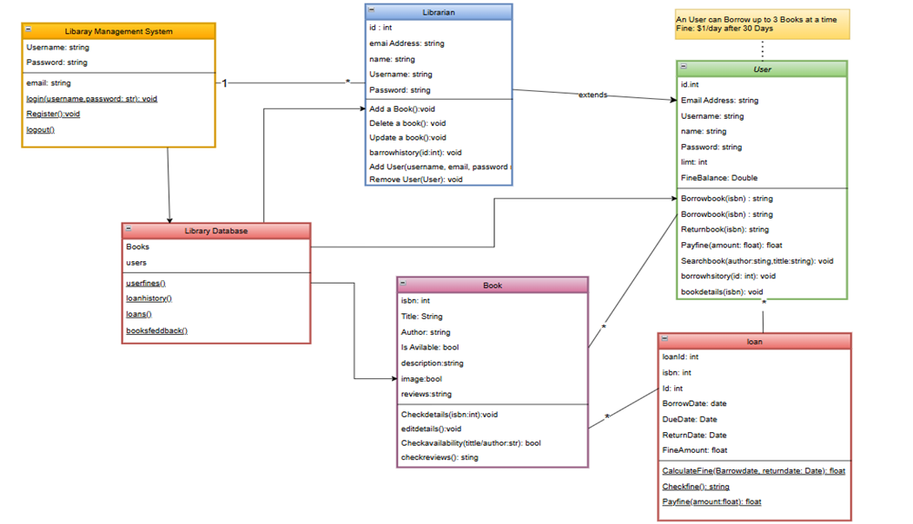
Class diagram:
It presents a comprehensive object-oriented design of the Library Management System, capturing the entities, behaviors, and relationships that define the system’s architecture.
The User class encapsulates all typical functionalities available to regular patrons of the library.
The Librarian class is equipped with administrative methods. include adding new books, deleting or updating existing book records, viewing any user's borrowing history.
At the backend, all data is centrally managed by the Library Database class, which contains collections of books and users.

Slide 13
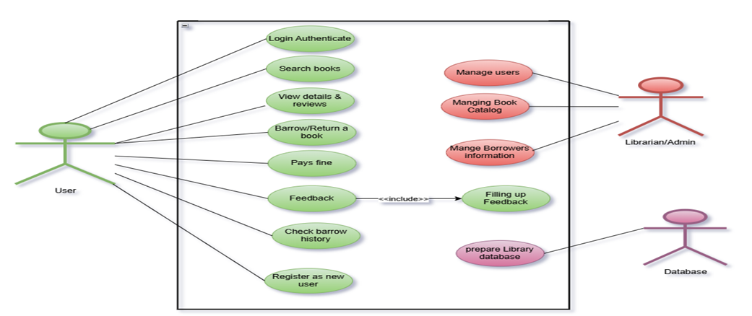
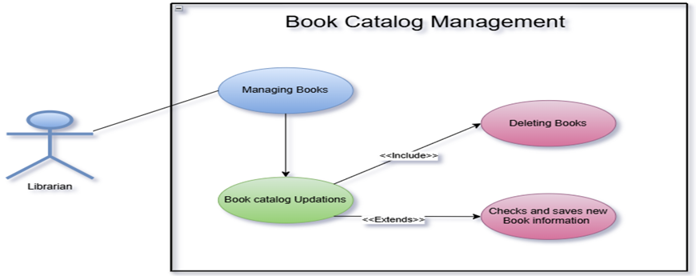
Use case diagram:
The use case diagrams provide a clear understanding of the functional interactions between various actors, users, librarians/admins, and the database and the Library Management System.
The User interacts with the system by performing logging in for authentication, searching for books, viewing book details and reviews, borrowing, etc..
The Librarian/Admin is responsible for overseeing the backend operations of the system. keeping the catalog up-to-date, and monitoring user activities.

Slide 14
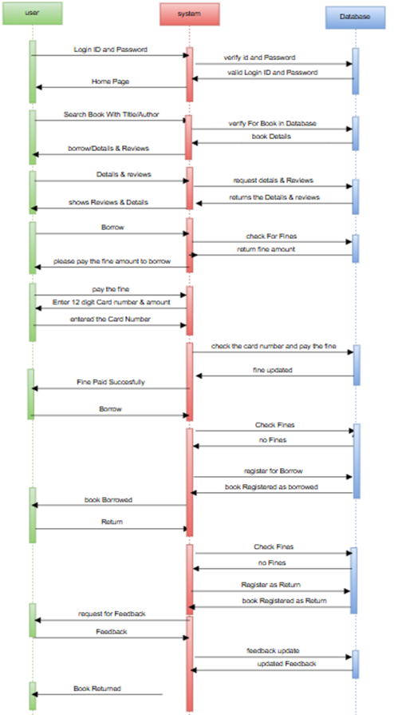
Sequence Diagram:
illustrates the interaction between a User, the Library Management System, and the Database during the complete book borrowing and feedback process.
This sequence effectively captures the user’s full interaction cycle with the system covering search, borrow, fine handling, return, and feedback ensuring a smooth and rule-compliant user experience.

Slide 15
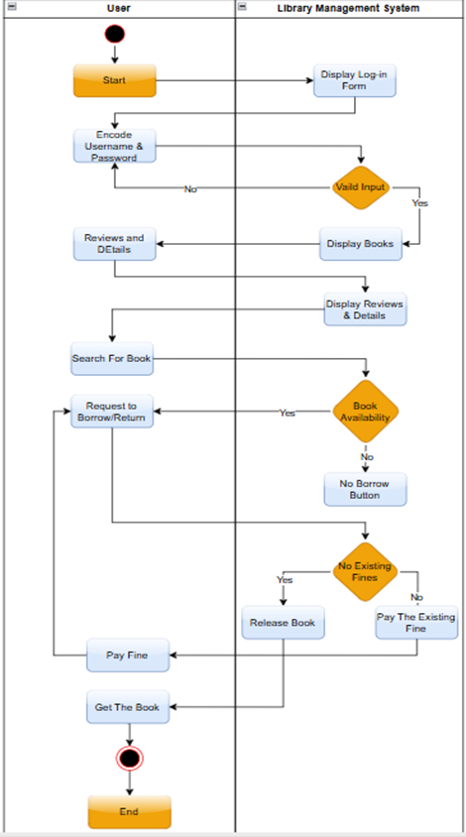
Activity Diagrams:
This activity diagram represents how a User (student or staff) interacts with the LMS. The session starts with the user logging in. After successful authentication, the user is taken to the homepage, where they can browse or search for books and view book details etc.
This workflow enforces borrowing rules, fine management, and system security, ensuring that users interact with the LMS in a fair and structured manner.

Slide 16
Results & Discussion
The Library Management System project delivered a fully functional, role-based web application that meets the needs of both users and librarians.
Users can register, log in, search for books, borrow and return items, pay fines, and leave feedback all through an intuitive, user-friendly interface.
Librarians have access to administrative tools for managing books, users, and borrowing records, including the ability to generate borrower reports.
Throughout the project, software engineering best practices were followed using the SOLID principles. The system maintained a modular, scalable structure by assigning distinct responsibilities across components (SRP)

Slide 17
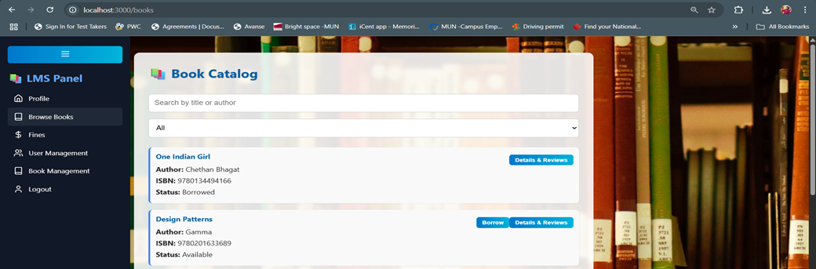
Cont..
The User Interface of a regular user interacting with the Book Catalog.
Through this, a user can borrow and return books, search for books using keywords, and view feedback or reviews related to a specific book.

Slide 18
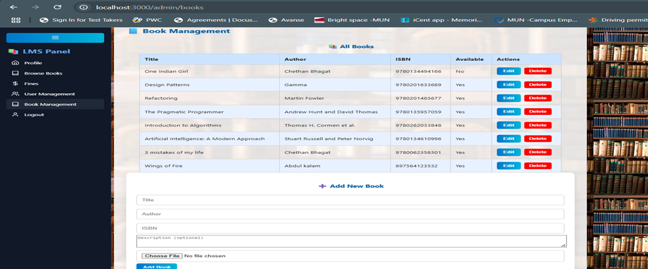
Cont..
The User Interface of an Admin/Librarian with options to add & edit books.
Through this, the admin can add new books, delete or update existing book records in the Data base.

Slide 19
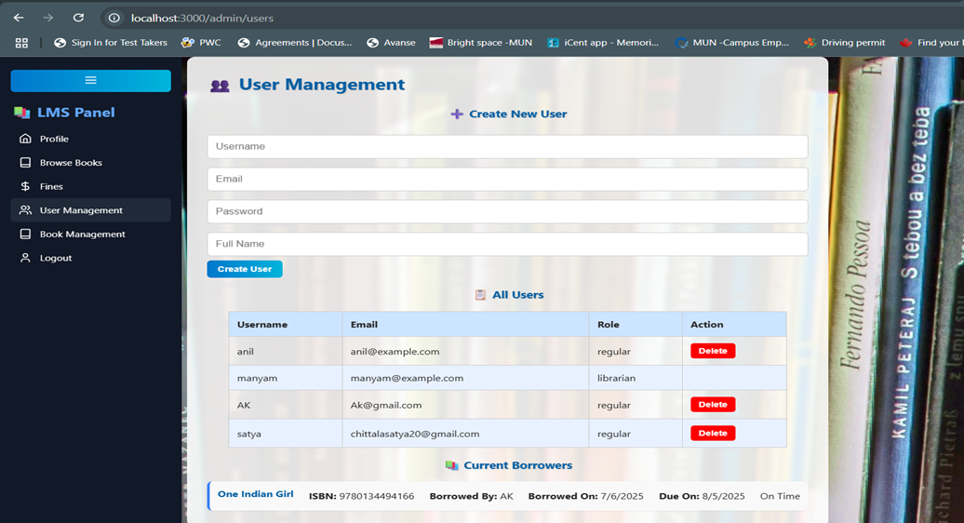
Cont..
Admin Page with User Management & Current Borrowers View

Slide 20
Future work & Limitations
It currently lacks session management. Future improvements should include session management using JWT.
The fine payment also can be integrated with real payment gateways like Stripe or PayPal.

Slide 21
References
[1] F. F. Okumuş, A. Ramic, and S. Kugele, “A Systematic Mapping Study on Contract-based Software Design for Dependable Systems,” arXiv preprint arXiv:2505.07542, 2025. [Online]. Available: https://arxiv.org/abs/2505.07542.
[2] B. Meyer, “Applying ‘Design by Contract’,” Computer, vol. 25, no. 10, pp. 40–51, Oct. 1992. https://doi.org/10.1109/2.161279.
[3] W. N. A. W. Mohd, R. Ahmad, M. F. M. Mohsin, and A. H. Abdullah, “Ontology-Based Library Management: Building a Semantic LMS,” in Proc. 2020 6th Int. Conf. on Information Management (ICIM), London, UK, 2020. https://doi.org/10.1109/ICIM49319.2020.244689

Slide 22


